Slide 1
Retail Sales Data Project
Data Analyst - OORJA GUND
E-mail- oorja.gund28@gmail.com

Slide 2
BUSINESS CONTEXT
Problem Statement
Objective
The Retail client wants help in measuring, and analyzing the performance of the business, by identifying key areas like customer behaviors, product behavior, store behavior, etc.
The client has provided Point of sales data for period Sep 2021 to Oct 2023 for 37 stores out of 534 stores across 7 states.
To provide data driven analysis of key metrics at product level, customer level, sales level, store level, etc.
To define CRM/ marketing/ campaign/ Sales strategies for the upcoming year.
To suggest a strategy to increase sales in the upcoming year.
Image source: icons8`

Slide 3
APPENDIX
OVERVIEW OF TABLES
ENTITY RELATIONSHIP DIAGRAM
DATA INCONSISTENCIES
DATA CLEANING
EXPLORATORY DATA ANALYSIS
CUSTOMER BEHAVIOR
CUSTOMER SATISFACTION
CATEGORY BEHAVIOR
CROSS-SELLING PRODUCTS
COHORT ANALYSIS
SALES TRENDS & SEASONALITY
FINAL RECOMMENDATIONS
Image source: icons8`

Slide 4
OVERVIEW OF TABLES
Total 6 tables have been provided:
Tables | No. of Columns | No. of Rows | Duplicates | Primary key | Foreign key | Parameters
Customer | 4 | 99,441 | 0 | Customer id | N/A | Customer-id, city, state, gender
Products info | 9 | 32,951 | 0 | Product id | N/A | Product-id, category, Product name length, description length, Product photos quantity, Product weight, length, height, and width
Stores info | 4 | 535 | 1 | Store id | N/A | Store-id, seller city, seller state, region
Image source: icons8`

Slide 5
OVERVIEW OF TABLES
Tables | No. of Columns | No. of Rows | Duplicates | Primary key | Foreign key | Parameters
Orders | 11 | 1,12,650 | 0 | Order id + Product id | Customer id, store id | Customer-id, Order-id, Product-id, channel, store-id, bill date, quantity, cost/unit, MRP, discount, total amount
Order payments | 3 | 103886 | 615 | N/A | Order id | Order-id, payment type, payment value
Order review ratings | 2 | 1,00,000 | 350 | N/A | Order id | Order-id, customer satisfaction score
Image source: icons8`

Slide 6
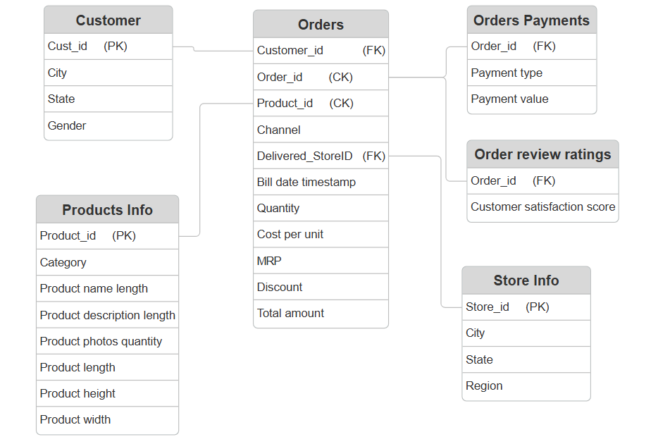
ENTITY RELATIONSHIP DIAGRAM
Customer-Orders → One-to-many
Products Info-Orders → One-to-many
Stores Info-Orders → One-to-many
OrdersPayments-Orders → Many-to-many
Order review-Orders → Many-to-one

Slide 7
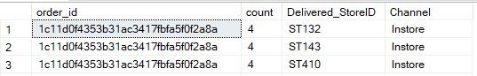
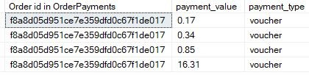
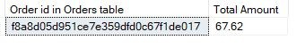
DATA INCONSISTENCIES
The dates in Orders table are not in proper format, which needs to be treated.
In Orders table, there are records in which same order ID and product ID are given with different quantity with same bill date and timestamp.
There are order_ids for “instore” and “Phone delivery” channels which have been given for more than one store id, which is not ideal.
There is some discrepancy in the Total amount given in Orders table and the payment value in OrderPayments table for same order_id.

Slide 8
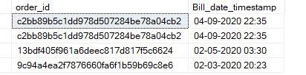
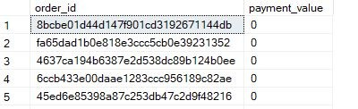
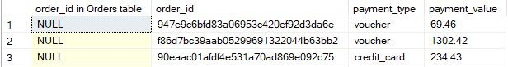
DATA INCONSISTENCIES
Though, in the introduction it has been mentioned that data is available from Sep 2021 to Oct 2023, but in the Orders table some records of 2020 are also present.
Some order_id in OrderPayments table have 0 payment value.
Also, there are order_ids in OrderPayments table that are not even present in orders table.

Slide 9
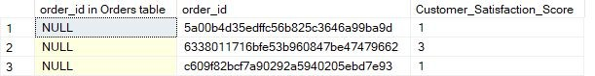
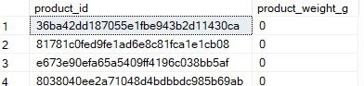
DATA INCONSISTENCIES
There are order_ids in OrderReview_Ratings table that are not even present in orders table.
There are records in ProductInfo table where weight is given 0.
Many columns in ProductInfo table have blank values.

Slide 10

DATA CLEANING

Slide 11
ORDERS TABLE
1,12,650
24,019
13,794
6,553
88,631
3,482 (8,032 records)
3,221 (7,283 records)
1,12,650- Raw data
88,631- records that matched with payment value in payments table.
13,794- records after picking out max quantity from 24,019 records.
6,553- these are order ids whose amount matched with payment value.
3,482- these are the ones that did not match, and total records for these were 8,032.
3,221- these order ids (total records-7,283) were found after replacing quantity by 1 and total amount by MRP-discount in the 8,032 records. Store ids were also replaced by the ones with max amount.
Final records => 88,631+6,553+7,283 = 1,02,467

Slide 12
FINAL TABLES
Customer level
98,311 rows
148 columns
Order level
1,02,467 rows
19 columns
Store level
37 rows
130 columns

Slide 13
EXPLORATORY DATA
ANALYSIS

Slide 14
KEY PERFORMANCE INDICATORS
SALES INFORMATION
ORDERS INFORMATION
Total Revenue: 15.8M
Total Cost: 13.5M
Total Profit: 2.25M
Profit %: 16.55%
Total discount: 0.51M
Discount %: 3.12%
Distinct Orders: 98,402
Payment methods: 4
Avg order value: 160.70
Avg discount per order: 5.20
Avg category per order: 1.041
Avg items per order: 1.142
Avg satisfaction score: 4.06

Slide 15
KEY PERFORMANCE INDICATORS
CUSTOMER INFORMATION
STORE INFORMATION
Total Customers: 98,311
Avg Profit per customer: 22.84
Avg customer spent: 160.85
Avg discount per customer: 5.20
Avg customer frequency: 1
Avg days btw two transactions: 5
Churn rate(>=90days): 94.36%
Repeat buyers: 36
Total Stores: 37
Total States: 7
Total Regions: 4

Slide 16
EXPLORATORY DATA ANALYSIS

Slide 17
EXPLORATORY DATA ANALYSIS

Slide 18
EXPLORATORY DATA ANALYSIS

Slide 19
EXPLORATORY DATA ANALYSIS

Slide 20
EXPLORATORY DATA ANALYSIS

Slide 21
EXPLORATORY DATA ANALYSIS

Slide 22
EXPLORATORY DATA ANALYSIS

Slide 23
EXPLORATORY DATA ANALYSIS

Slide 24
EXPLORATORY DATA ANALYSIS
INSIGHTS
Regional sales analysis highlighted the South as the top-performing region, while the East lagged behind.
Among the states, Andhra Pradesh recorded the highest sales figures, closely followed by Gujarat, with West Bengal reporting the lowest numbers.
The business faced a considerable dip in new customer acquisitions during 2021. However, the situation improved notably in subsequent years, with acquisition rates peaking in November and August.
Revenue trends showed a positive trajectory starting from January 2022, with steady growth observed until August 2023. Notably, there was a sharp drop in September 2023, alongside a minor dip previously in December 2022.
Stores in the South, especially in Andhra Pradesh, showed strong demand for items in the Toys & Gifts, Home Appliances, and Food & Beverages segments. Meanwhile, Gujarat exhibited a preference for Baby products, marking it as the leading category in that state.

Slide 25
CUSTOMER BEHAVIOR

Slide 26
CUSTOMER BEHAVIOR
Gender | Revenue | Profit
F | 11061767.48 | 70.21%
M | 4751092.59 | 29.79%

Slide 27
CUSTOMER BEHAVIOR

Slide 28
CUSTOMER BEHAVIOR
High spender → >P66(9,018)
Medium spender→ b/w P66(9,018) & P33(4,509)
Low spender→ <P33(4,509)

Slide 29
CUSTOMER BEHAVIOR
RFM Segmentation
RECENCY(R): How recently a customer made a purchase.
FREQUENCY(F): How often a customer makes a purchase over a certain period.
MONETARY(M): How much money a customer spends on purchases over a certain period.
Recency Segment
Active(Score=1) - <90 days
At Risk(Score=2) - >90 & <180 days
Frequency Segment
High(Score=1) - 3
Mid(Score=2) – 2
Churned(Score=3) - >180 days
Low(Score=3) – 1
Monetary Segment
High(Score=1) - >7k
Medium(Score=2) - >3k & <7k
Low(Score=3) - <3k

Slide 30
CUSTOMER BEHAVIOR
Final Scores upon combining R,F & M segments:
Platinum = 3
Gold = 4 or 5
Silver = 6 or 7
Regular = 8 or 9
Only Silver and Regular segment customers are available for the most recent year 2023.
Segment | Customer Count
REGULAR | 48,997
SILVER | 5,568

Slide 31
CUSTOMER BEHAVIOR
RFM ANALYSIS
Recommendations:
Upgrade Strategies for Regular Customers: Develop initiatives to encourage Regular segment customers to transition to premium tiers like Gold and Platinum. These could include tailored promotions, unique offers, and superior customer service.
Awareness Campaigns for Regular Customers: Build awareness among Regular customers about the benefits of upgrading to premium segments. Highlight the perks of frequent shopping and increased spending, such as access to premium offerings and exclusive services.
Retention Plans for Silver Customers: Focus on creating loyalty programs specifically designed for Silver segment customers to retain them and boost their spending. Provide exclusive perks and rewards to keep these valuable customers engaged.

Slide 32
CUSTOMER BEHAVIOR
Gender
 | F |  | M
Channel | Revenue | Profit% | Revenue | Profit%
Instore | 9699245.18 | 61.65% | 4165443.6 | 26.16%
Phone Delivery | 1167892.39 | 7.39% | 495287.99 | 3.14%
Online | 194629.91 | 1.16% | 90360.95 | 0.49%

Slide 33
CUSTOMER BEHAVIOR

Slide 34
CUSTOMER BEHAVIOR

Slide 35
CUSTOMER BEHAVIOR
Types of Customers | No. of Customers | Percentage
One-time buyers | 98,275 | 99.96%
Repeat buyers | 36 | 0.036%
Discount seekers | 40,186 | 40.87%
Non-discount seekers | 58,125 | 59.13%
One-Category buyers | 97,569 | 99.25%
Multi-Category buyers | 742 | 0.75%
All Channels buyers | 1 | 0.001%

Slide 36
CUSTOMER BEHAVIOR

Slide 37
CUSTOMER BEHAVIOR

Slide 38
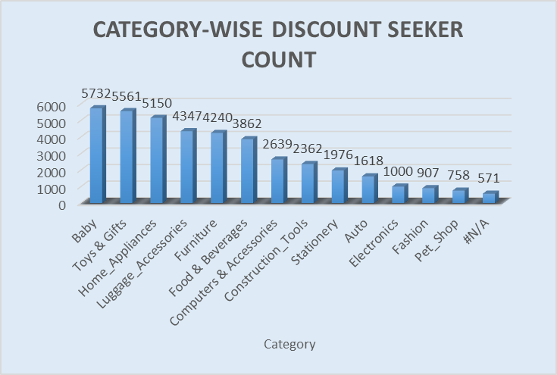
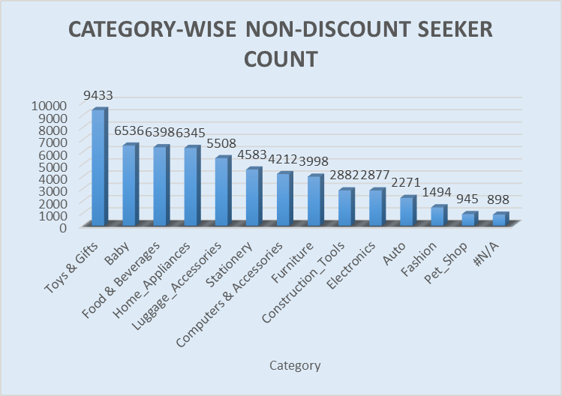
CUSTOMER BEHAVIOR

Slide 39
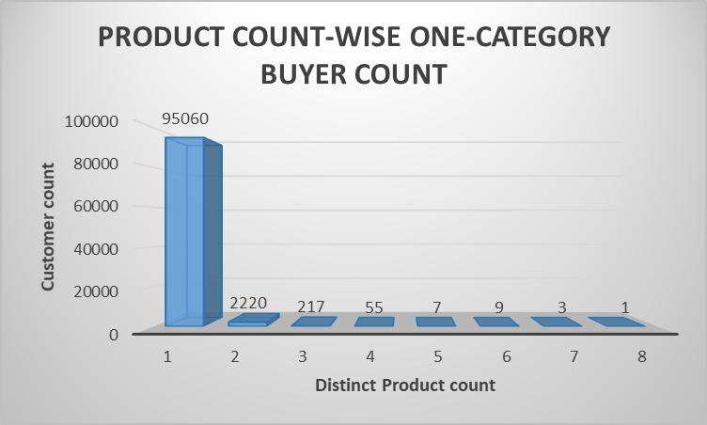
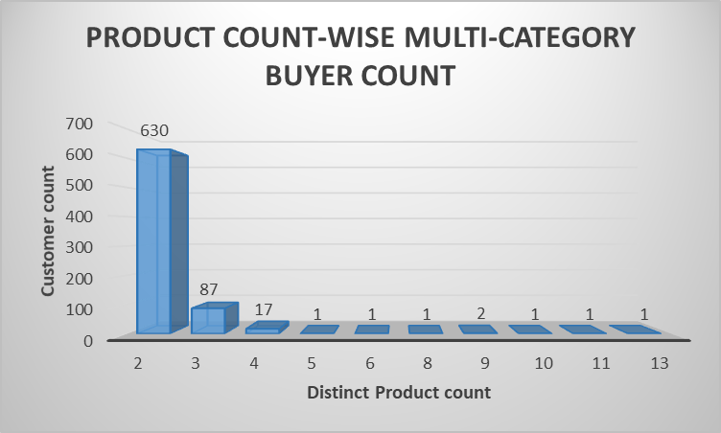
CUSTOMER BEHAVIOR

Slide 40
CUSTOMER BEHAVIOR
INSIGHTS
Both One-time and Repeat buyers are coming from almost same customer states, among which Andhra Pradesh is top-most.
In-Store channel is the most popular among all customers, whether one-time buyer or repeat buyer, and it offers highest discount. Also, both genders prefer in-store channel for purchases, in which female customers provide higher revenue.
Customer count increases as per discount offered by states, in which Andhra Pradesh offers highest discount.
Toys & gifts and Baby categories are the most popular among the customers, whether discount is offered or not.
RECOMMENDATIONS
Analyze factors like customer engagement techniques in high-retention states. Roll out similar campaigns or customer experience enhancements in states with low repeat buyer ratios.
Develop targeted campaigns for discount seekers and non-discount seekers to maximize engagement and sales.

Slide 41
CUSTOMER SATISFACTION

Slide 42
CUSTOMER SATISFACTION

Slide 43
CUSTOMER SATISFACTION

Slide 44
CUSTOMER SATISFACTION
RECOMMENDATIONS
Sustain High-Performance Levels: Prioritize maintaining excellence in the top-performing categories to ensure consistent customer satisfaction. Leverage insights from these successful areas to implement effective strategies in other categories.
Boost Performance in Underperforming Categories: Focus on understanding customer concerns in the Furniture, Baby, and Computer & Accessories categories through detailed feedback analysis. Address these issues by enhancing product quality, improving services, or running targeted promotions to drive growth in these segments.

Slide 45
CATEGORY BEHAVIOR

Slide 46
CATEGORY BEHAVIOR
Category | Revenue | Profit%
Toys & Gifts | 2635924.99 | 12.28%
Home_Appliances | 1790739.81 | 13.37%
Baby | 1719088.72 | 12.14%
Food & Beverages | 1647930.85 | 9.65%
Luggage_Accessories | 1644070.48 | 10.21%
Furniture | 1359748.91 | 11.80%
Computers & Accessories | 1290661.55 | 6.99%
Construction_Tools | 1101736.51 | 5.74%
Auto | 685105.57 | 4.12%
Stationery | 679409.07 | 5.29%
Electronics | 548679.73 | 3.54%
Pet_Shop | 252824.75 | 1.75%
Fashion | 243572.12 | 1.85%
#N/A | 213367.01 | 1.27%

Slide 47
CATEGORY BEHAVIOR
PARETO ANALYSIS
Categories | Total Revenue | Cumulative Sale | Cum % of Sale
Toys & Gifts | 2.64 M | 2.64 M | 16.67%
Home_Appliances | 1.79 M | 4.43 M | 27.99%
Baby | 1.72 M | 6.15 M | 38.87%
Food & Beverages | 1.65 M | 7.79 M | 49.29%
Luggage_Accessories | 1.64 M | 9.44 M | 59.68%
Furniture | 1.36 M | 10.80 M | 68.28%
Computers & Accessories | 1.29 M | 12.09 M | 76.45%
Construction_Tools | 1.10 M | 13.19 M | 83.41%
Auto | 0.69 M | 13.88 M | 87.75%
Stationery | 0.68 M | 14.55 M | 92.04%
Electronics | 0.55 M | 15.10 M | 95.51%
Pet_Shop | 0.25 M | 15.36 M | 97.11%
Fashion | 0.24 M | 15.60 M | 98.65%
#N/A | 0.21 M | 15.81 M | 100.00%
Pareto Analysis is based on 80/20 rule, which states that roughly 80% of effects come from 20% of causes.
Pareto Analysis of Total Sales involves identifying and focusing on the key contributors that generate the majority of the total sales.
According to this data, around 50% of the categories (till “Construction_Tools”) contribute approx. 80% of total sales.

Slide 48
CATEGORY BEHAVIOR

Slide 49
CATEGORY BEHAVIOR
Category Penetration = No. of orders containing the category x 100
Total no. of orders

Slide 50
CATEGORY BEHAVIOR
INSIGHTS
Toys & Gifts category generates the highest revenue and profit percentage among all categories. It also leads in category penetration, accounting for 15.24% of the total customers, indicating strong customer interest and engagement in this category.
Fashion and Pet Shop category are one of the least performing categories in terms of sales and profit, reflecting either a lack of demand or issues with product assortment, pricing, or promotions.
Pareto Analysis highlights a dependency on a select few categories(around 50%) for the majority of revenue.
RECOMMENDATIONS
Identify underrepresented but promising categories and develop strategies to increase their visibility and customer interest, such as bundling with high-performing categories or improving product assortment.
For categories contributing significantly to sales, focus on maintaining their momentum by ensuring competitive pricing, excellent stock availability, and promotional support.

Slide 51
CROSS-SELLING PRODUCTS

Slide 52
CROSS-SELLING PRODUCTS

Slide 53
CROSS-SELLING PRODUCTS
Top 10 combinations of 3 Categories sold together:
Category1 | Category2 | Category3 | Frequency
Construction_Tools | Stationery | Toys & Gifts | 2
#N/A | Baby | Luggage_Accessories | 2
Computers & Accessories | Construction_Tools | Home_Appliances | 2
Computers & Accessories | Food & Beverages | Luggage_Accessories | 1
Auto | Electronics | Fashion | 1
Furniture | Luggage_Accessories | Pet_Shop | 1
Baby | Luggage_Accessories | Toys & Gifts | 1
Baby | Furniture | Home_Appliances | 1
Furniture | Home_Appliances | Toys & Gifts | 1
Auto | Baby | Construction_Tools | 1

Slide 54
CROSS-SELLING PRODUCTS
Recommendations
Focused Promotions: Design targeted campaigns that combine, for example, Baby Products with Home appliances products to attract and engage specific customer segments. This could include a loyalty program that rewards customers for purchasing across multiple product categories.
Customized Recommendations: Use customer data to provide personalized product suggestions aligned with their past purchases.
Behavior-Based Segmentation: Segment customers based on their shopping behaviors and develop tailored marketing strategies for each group.

Slide 55
COHORT ANALYSIS

Slide 56
COHORT ANALYSIS FOR FIXED MONTH
Years | Months | New Cust Acquired | Total Cust retained | Retention Rate | Avg Months Repeated Customers | Total revenue by new customer | Total quantity by new customer | Total revenue by retention customer | Total quantity by retention customer
2021 | 8 | 8 | 0 | 0 | 0 | 1102.38 | 9 | 0 | 0
2021 | 9 | 9 | 0 | 0 | 0 | 1864 | 13 | 0 | 0
2021 | 10 | 222 | 0 | 0 | 0 | 39420.94 | 252 | 0 | 0
2021 | 11 | 42 | 0 | 0 | 0 | 8152.17 | 49 | 0 | 0
2021 | 12 | 25 | 0 | 0 | 0 | 5784.16 | 32 | 0 | 0
2022 | 1 | 1665 | 2 | 0.12 | 2 | 261773.46 | 1981 | 182.53 | 2
2022 | 2 | 1707 | 1 | 0.059 | 15 | 280003.17 | 1927 | 18.56 | 1
2022 | 3 | 3064 | 2 | 0.065 | 7 | 506532.66 | 3525 | 348.62 | 2
2022 | 4 | 2662 | 1 | 0.038 | 6 | 442323.85 | 3029 | 110.84 | 1
2022 | 5 | 3732 | 3 | 0.08 | 2 | 595396.67 | 4233 | 473.63 | 5
2022 | 6 | 3401 | 2 | 0.059 | 5 | 573751.71 | 3842 | 317.3 | 2
2022 | 7 | 4006 | 2 | 0.05 | 2 | 607440.63 | 4563 | 238.13 | 2
2022 | 8 | 4175 | 3 | 0.072 | 6 | 656110.07 | 4806 | 258.14 | 3
2022 | 9 | 4103 | 0 | 0 | 0 | 659008.15 | 4630 | 0 | 0

Slide 57
COHORT ANALYSIS FOR FIXED MONTH
Years | Months | New Cust Acquired | Total Cust retained | Retention Rate | Avg Months Repeated Customers | Total revenue by new customer | Total quantity by new customer | Total revenue by retention customer | Total quantity by retention customer
2022 | 10 | 4129 | 2 | 0.048 | 5 | 675407.1 | 4757 | 509.41 | 3
2022 | 11 | 6195 | 4 | 0.065 | 4 | 995679.28 | 7141 | 629.13 | 4
2022 | 12 | 4601 | 2 | 0.043 | 2 | 734385.37 | 5193 | 286.03 | 2
2023 | 1 | 5962 | 0 | 0 | 0 | 909597.31 | 6750 | 0 | 0
2023 | 2 | 5625 | 2 | 0.036 | 5 | 848400 | 6449 | 194.66 | 3
2023 | 3 | 6042 | 2 | 0.033 | 3 | 964812.84 | 6954 | 297.76 | 2
2023 | 4 | 5222 | 3 | 0.057 | 5 | 876817.72 | 6018 | 360.74 | 5
2023 | 5 | 6101 | 0 | 0 | 0 | 1013474.24 | 7086 | 0 | 0
2023 | 6 | 5931 | 2 | 0.034 | 2 | 977233.41 | 6812 | 423.29 | 4
2023 | 7 | 5437 | 3 | 0.055 | 1 | 890979.85 | 6149 | 476.06 | 3
2023 | 8 | 6618 | 0 | 0 | 0 | 1037869.19 | 7459 | 0 | 0
2023 | 9 | 2123 | 0 | 0 | 0 | 345313.63 | 2419 | 0 | 0
2023 | 10 | 1762 | 0 | 0 | 0 | 295999.74 | 1993 | 0 | 0
2023 | 11 | 1848 | 0 | 0 | 0 | 317394.88 | 2120 | 0 | 0
2023 | 12 | 1894 | 0 | 0 | 0 | 290831.49 | 2148 | 0 | 0

Slide 58
COHORT ANALYSIS FOR FIXED MONTH
INSIGHTS
For the total 29 cohorts, 36 customers have been retained after the cohort month.
The August 2023 cohort stands out with the highest number of new customers, reaching 6,619.
While, August 2021 cohorts has the smallest customer count, with 8 customers.
Retention rate was highest in August 2022 cohort, at 0.072%.
November 2022 recorded the highest total revenue from retained customers, amounting to INR 629.13.
The cohort from February 2022 shows the longest average time between repeat purchases, spanning 15 months.
13 cohorts did not have any customers making repeat purchases.

Slide 59
COHORT ANALYSIS RETENTION BY MONTH
Cohort_date | 0 | 1 | 2 | 3 | 4 | 5 | 6 | 7 | 8 | 9 | 10 | 11 | 12
01-08-2021 | 8 | 0 | 0 | 0 | 0 | 0 | 0 | 0 | 0 | 0 | 0 | 0 | 0
01-09-2021 | 9 | 0 | 0 | 0 | 0 | 0 | 0 | 0 | 0 | 0 | 0 | 0 | 0
01-10-2021 | 222 | 0 | 0 | 0 | 0 | 0 | 0 | 0 | 0 | 0 | 0 | 0 | 0
01-11-2021 | 42 | 0 | 0 | 0 | 0 | 0 | 0 | 0 | 0 | 0 | 0 | 0 | 0
01-12-2021 | 25 | 0 | 0 | 0 | 0 | 0 | 0 | 0 | 0 | 0 | 0 | 0 | 0
01-01-2022 | 1665 | 0 | 0 | 0 | 0 | 1 | 0 | 2 | 1 | 0 | 1 | 0 | 0
01-02-2022 | 1707 | 0 | 0 | 0 | 0 | 0 | 0 | 0 | 0 | 0 | 0 | 0 | 0
01-03-2022 | 3064 | 1 | 0 | 0 | 0 | 0 | 0 | 0 | 0 | 0 | 0 | 0 | 0
01-04-2022 | 2662 | 0 | 0 | 0 | 0 | 0 | 1 | 0 | 0 | 0 | 0 | 0 | 0
01-05-2022 | 3732 | 0 | 1 | 1 | 0 | 0 | 0 | 0 | 0 | 0 | 0 | 0 | 0
01-06-2022 | 3401 | 0 | 0 | 0 | 0 | 0 | 0 | 0 | 0 | 0 | 0 | 0 | 0
01-07-2022 | 4006 | 0 | 1 | 0 | 0 | 0 | 0 | 0 | 0 | 0 | 0 | 0 | 0
01-08-2022 | 4175 | 0 | 0 | 0 | 1 | 0 | 0 | 0 | 0 | 0 | 0 | 0 | 0
01-09-2022 | 4103 | 0 | 0 | 0 | 0 | 0 | 0 | 0 | 0 | 0 | 0 | 0 | 0
01-10-2022 | 4129 | 1 | 1 | 0 | 0 | 0 | 0 | 0 | 0 | 0 | 0 | 0 | 0

Slide 60
COHORT ANALYSIS RETENTION BY MONTH
Cohort_date | 0 | 1 | 2 | 3 | 4 | 5 | 6 | 7 | 8 | 9 | 10 | 11 | 12
01-11-2022 | 6195 | 0 | 0 | 0 | 0 | 0 | 0 | 0 | 0 | 0 | 0 | 0 | 0
01-12-2022 | 4601 | 0 | 0 | 0 | 0 | 0 | 0 | 0 | 0 | 0 | 0 | 0 | 0
01-01-2023 | 5962 | 0 | 0 | 0 | 0 | 0 | 0 | 0 | 0 | 0 | 0 | 0 | 0
01-02-2023 | 5625 | 0 | 0 | 0 | 0 | 1 | 1 | 0 | 0 | 0 | 0 | 0 | 0
01-03-2023 | 6042 | 0 | 0 | 0 | 2 | 0 | 0 | 0 | 0 | 0 | 0 | 0 | 0
01-04-2023 | 5222 | 0 | 0 | 0 | 1 | 0 | 2 | 0 | 0 | 0 | 0 | 0 | 0
01-05-2023 | 6101 | 0 | 0 | 0 | 0 | 0 | 0 | 0 | 0 | 0 | 0 | 0 | 0
01-06-2023 | 5931 | 0 | 0 | 0 | 1 | 0 | 0 | 0 | 0 | 0 | 0 | 0 | 0
01-07-2023 | 5437 | 2 | 0 | 1 | 0 | 0 | 0 | 0 | 0 | 0 | 0 | 0 | 0
01-08-2023 | 6618 | 0 | 0 | 0 | 0 | 0 | 0 | 0 | 0 | 0 | 0 | 0 | 0
01-09-2023 | 2123 | 0 | 0 | 0 | 0 | 0 | 0 | 0 | 0 | 0 | 0 | 0 | 0
01-10-2023 | 1762 | 0 | 0 | 0 | 0 | 0 | 0 | 0 | 0 | 0 | 0 | 0 | 0
01-11-2023 | 1848 | 0 | 0 | 0 | 0 | 0 | 0 | 0 | 0 | 0 | 0 | 0 | 0
01-12-2023 | 1894 | 0 | 0 | 0 | 0 | 0 | 0 | 0 | 0 | 0 | 0 | 0 | 0

Slide 61
COHORT ANALYSIS RETENTION BY MONTH
INSIGHTS
Customers from 3 cohorts(March 2022, Oct 2022, July 2023) have made purchases in the immediate next month after the cohort month.
January 2022 cohort has the highest number of repeat customers, with 5 individuals making repeat purchases within the following 10 months.
Customers from 17 cohorts did not make any purchases in the following 12 months.
Last 5 cohorts did not have any repeat customers in the following 12 months.

Slide 62
SALES TRENDS & SEASONALITY

Slide 63
SALES TRENDS & SEASONALITY
Month | Revenue | Profit%
Jan | 1171800.85 | 7.45%
Feb | 1128080.31 | 7.27%
Mar | 1470749.13 | 9.57%
Apr | 1318061.37 | 8.12%
May | 1608857.98 | 9.79%
Jun | 1550686.56 | 9.93%
Jul | 1498339.49 | 9.83%
Aug | 1694562.3 | 10.80%
Sep | 1007083.19 | 6.28%
Oct | 1012028.22 | 6.28%
Nov | 1321280.27 | 8.22%
Dec | 1031330.4 | 6.46%

Slide 64
SALES TRENDS & SEASONALITY

Slide 65
SALES TRENDS & SEASONALITY

Slide 66
SALES TRENDS & SEASONALITY

Slide 67
SALES TRENDS & SEASONALITY

Slide 68
SALES TRENDS & SEASONALITY
Recommendations
Identify Causes for Sales Reductions: Examine the factors leading to noticeable decreases in sales, such as the dip observed from September 2023.
Customize Marketing and Product Strategies: Gain insights into different customer segments that influence sales trends and contribution, allowing for more targeted marketing and tailored product offerings. As revenue tends to rise with higher discounts, offering greater and regular discounts could be an effective strategy.
Identify Operational Shortcomings: Review and improve operational processes to enhance efficiency and compare performance with industry competitors. Also, analyze external elements like unforeseen challenges or shifts in industry trends.

Slide 69
FINAL RECOMMENDATIONS

Slide 70
RECOMMENDATIONS FOR WEAK POINTS
CUSTOMER RETENTION
Personalized Communication: Use customer data to send tailored emails or messages about exclusive offers, product recommendations, or personalized discounts.
Post-Purchase Engagement: Stay connected with customers after their purchase by sending thank-you notes, feedback surveys, or tips on using their product effectively.
Exceptional Customer Service: Provide prompt and friendly customer support through multiple channels to resolve issues quickly and build trust.
Special Offers for Returning Customers: Offer returning customers exclusive discounts, early access to sales, or free shipping to incentivize repeat purchases.
LOW SALES
Leverage Customer Insights: Use customer data to understand shopping patterns and preferences, enabling the creation of personalized offers that drive higher engagement.
Analyse previous data: Leverage historical sales data to identify recurring patterns and predict future trends, enabling better planning and resource allocation.
Boost Friday Sales: Launch "Friday Specials" or limited-time offers to encourage customers to visit and shop more at the end of the workweek.
Less popular categories: Combine these categories with top-performing ones and offer promotions to boost sales.

Slide 71
RECOMMENDATIONS FOR STRONG POINTS
Optimize Sales During Peak Times: As sales spike after midnight and again after 8 in the morning, launch targeted promotions during these hours to maximize revenue.
Enhance In-Store Experience: Since In-Store channel is most preferred by the customers, invest in improving the in-store experience further. This could involve training staff to offer exceptional service.
Expand Product Assortment: Based on customer preferences and strong-performing product categories (like for combination of Baby and home appliances products), consider introducing complementary items to enhance the offering.
Positive Customer Ratings: Positive customer ratings can be used in marketing campaigns, website content, or social media to highlight customer satisfaction and boost brand reputation.

Slide 72
Thank you!

